Slide 1
App Store Data Challenge
By: Jason Yang
Friday, March 4th, 2022

Slide 2
Executive Summary
Opportunity in providing free app downloads to PMOF accounts

Slide 3
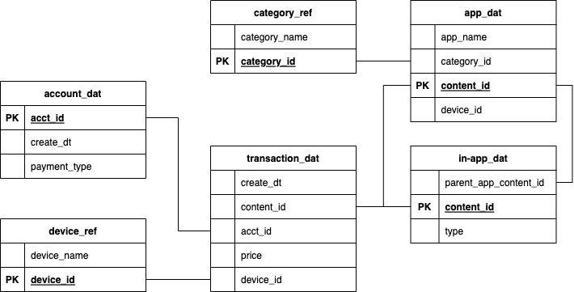
Data

Slide 4
Data
“Download”
Consumable
Subscription

Slide 5
Data

Slide 6
Data
Entertainment
Games
Photos & Videos
Social Networking
Utilities
Free only
PMOF
“unknown”

Slide 7
Question: How do Apps deliver better value to users?

Slide 8
Pay to Win
Users are paying a lot of money in Games apps
Are PMOF accounts getting good value from these transactions?

Slide 9
“Price is what you pay; Value is what you get.”
Warren Buffet

Slide 10
Free only vs PMOF Accounts
Free only accounts have much more downloads than PMOF accounts
Are Free only accounts getting good value from these transactions?

Slide 11
Free, But Not as Good?
Free accounts download at least 2x more apps than PMOF accounts
Potential bad experiences:
Lots of Ads
Unsupported App (no revenue)
Bad App

Slide 12
PMOF Account Download Time Series

Slide 13
PMOF Account Game App Downloads

Slide 14
Opportunity: Free App Downloads for PMOF
Measuring success as having more accounts downloading an app.
Lowering cost barrier to PMOF apps have the most success in delivering value

Slide 16
Recommendation

Slide 20
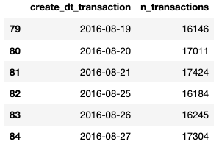
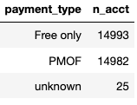
Data Quality Issues
25 acct_id’s without payment_type
data gap on 2016-08-22 to 2016-08-24

Slide 21
Next Level
I want to do a deeper analysis with more data including:
App usage metrics like crashes, duration, and rating
Better define what a “good” app
Account attributes like age, Apple subscriptions
Create account segments

Slide 22
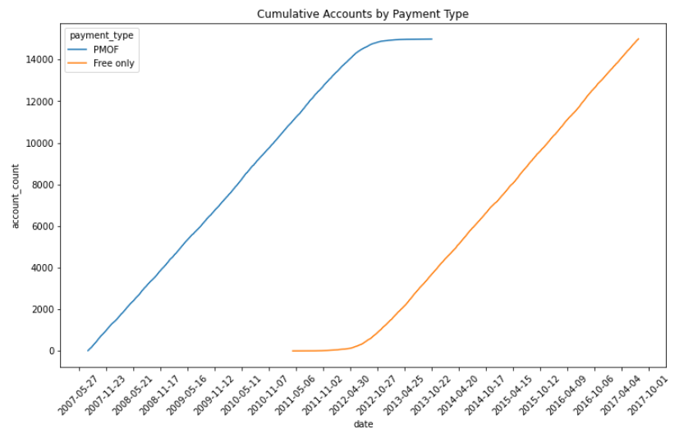
Appendix

Slide 23
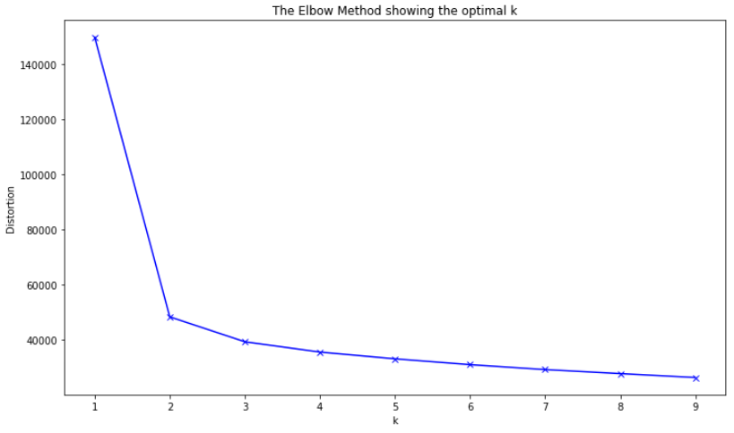
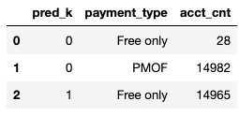
Appendix

